Slide 1
Conductivity
Ilya Belopolski, Sheldon Kwok
TAs: Dr. Benjamin Nachumi, Kenneth Sikes
Physics W3081, Professor May

Slide 2
Introduction
Measure the response of crystalline solids to applied electric fields as a function of temperature
Fundamental properties of solid state systems
Physical basis for modern electronics
Critical temperature of NbTi superconductor
Resistance as a function of temperature in Pt
Curie point and magnetization of Ni
Band gap of Si using a PN junction

Slide 3
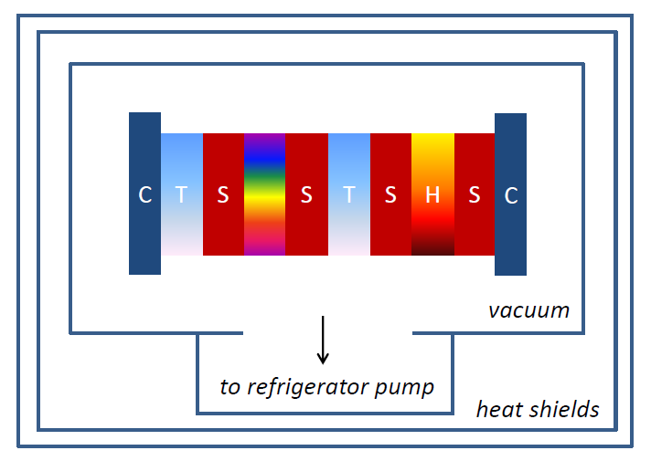
Methods
Low-temperature measurements in helium refrigerator
High-temperature measurements in oven
Measurement setup:

Slide 4
Methods
Measure small resistances with four-point contact measurement:
Seebeck effect: measurement error due to thermal gradient across leads
Alternate the direction of applied current, take two voltage measurements, and average them
V-
V+
R
I-
I+

Slide 5
Superconductivity
Below a critical temperature T_{c} , superconductors carry current without resistance
Low-temperature superconductivity (T_{c} < 40Κ), predicted by BCS theory (1957)
  Electron-phonon interactions create Cooper pairs
  Cooper pairs form Bose-Einstein condensate, insensitive to disorder, so no resistivity
High-temperature superconductivity (T_{c} > 40Κ) unexplained, various pairing mechanisms proposed

Slide 6
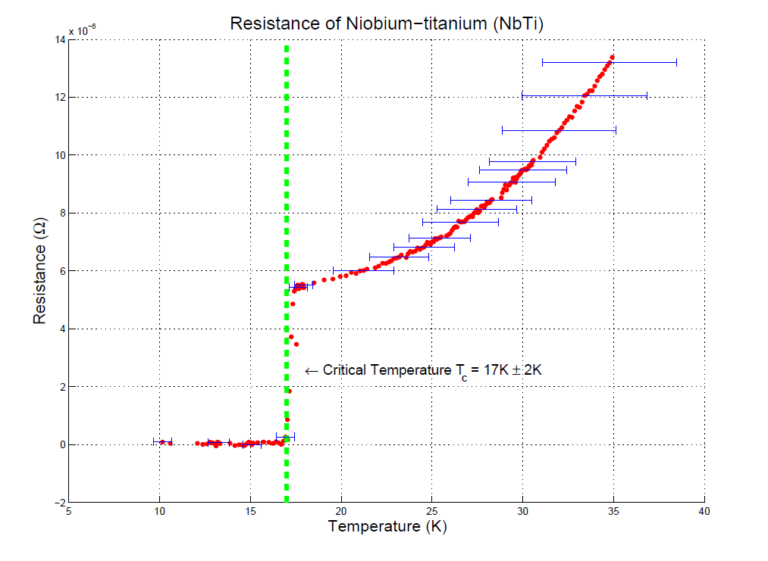
Accepted value: 19 K

Slide 7
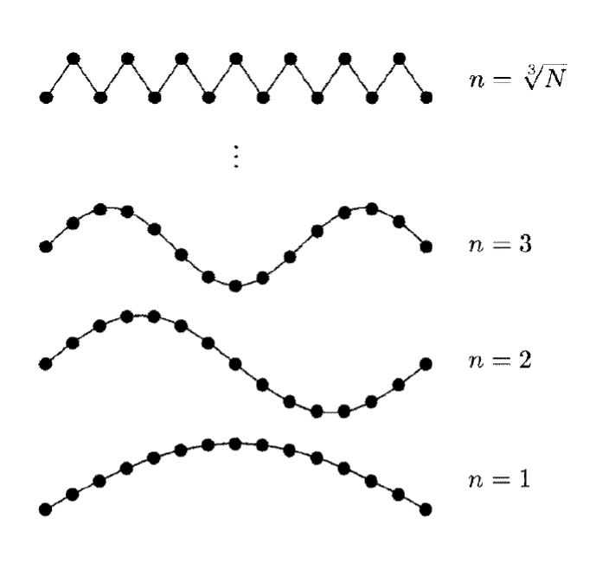
Bloch-Grüneisen Conductivity
Assume that resistance due to electron-phonon scattering
Phonons obey Bose-Einstein statistics: different phonon excitation populations at different temperatures
Finite number of possible excitations determined by lattice spacing and crystal size

Slide 8

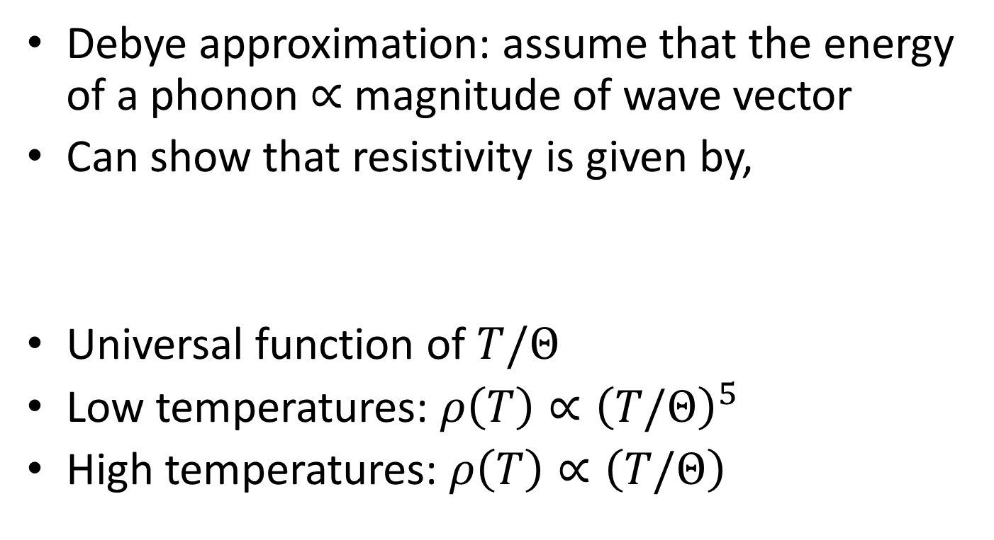
Bloch-Grüneisen Conductivity
Debye approximation: assume that the energy of a phonon $∝$ magnitude of wave vector
Can show that resistivity is given by,
Universal function of $T/Θ$
Low temperatures: $ρ\left(T\right)∝{\left(T/Θ\right)}^{5}$
High temperatures: $ρ\left(T\right)∝\left(T/Θ\right)$

Slide 9
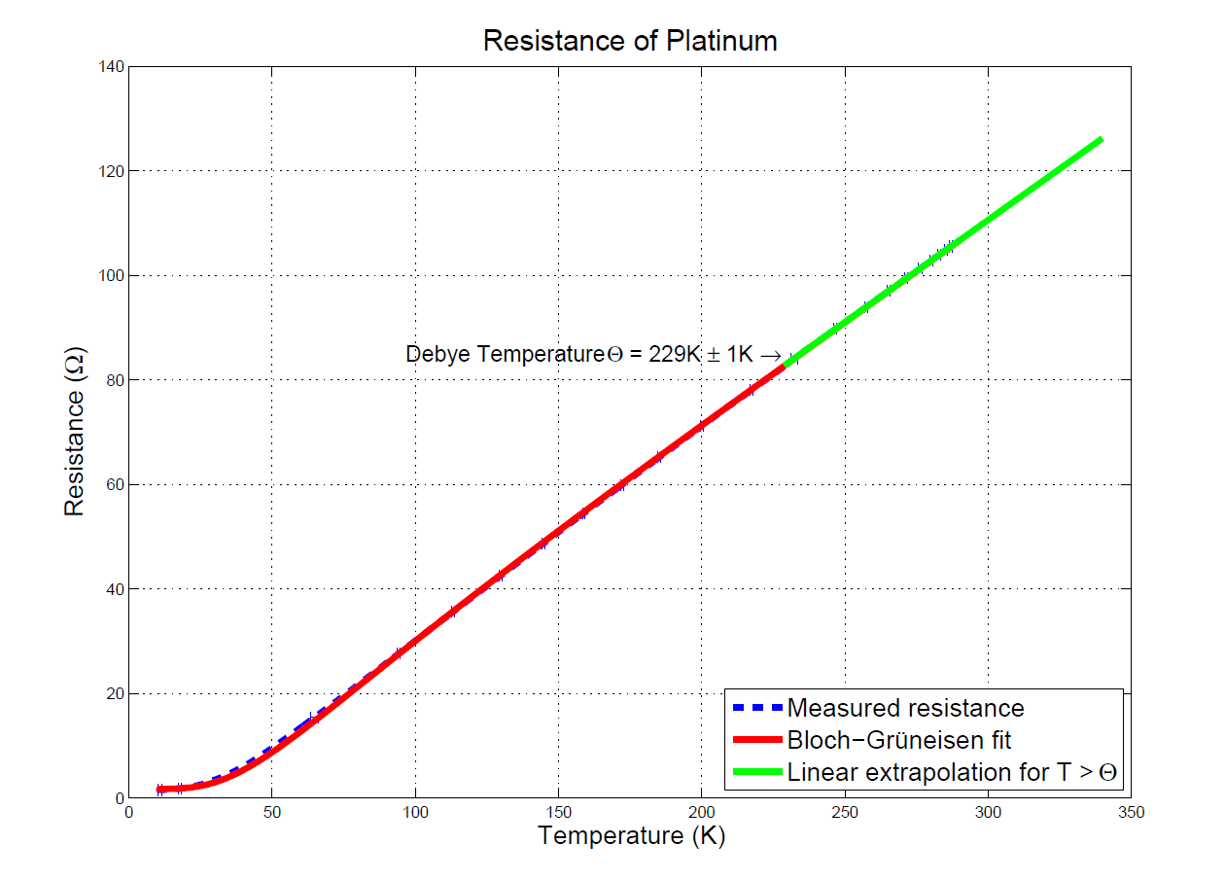
Accepted value: 230 K

Slide 10
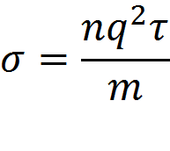
Conductivity near the Curie Point
Magnetization = difference in # of oppositely polarized electrons
Energetically favorable for electron spins to align
When T is lowered, number of conducting charges (n) increases, and mean free time (τ) increases
Change in resistance below the Curie Point is proportional to the square of the magnetization
where σ is conductivity, q is charge and m is mass

Slide 11
Curie Point of Nickel
Known Curie Point for Nickel : 631 K

Slide 12
Magnetization of Nickel

Slide 13
P-N Junction
N-Type
P-Type
Conduction Band
Electrons/Negative Carriers
Band Gap
Valence Band
Holes/Positive Carriers
N type (extra negative carriers), P type (extra positive carriers)
Positive Potential
Majority Negative Carriers
Minority Positive Carriers
p-side
Natural Potential Difference (V₀) + Applied Potential Difference (V)
x
n-side
Majority Positive Carriers
Minority Negative Carriers

Slide 14
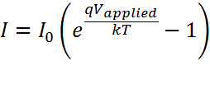
P-N Junction
Positive Potential
Minority Positive Carriers
p-side
Natural Potential Difference (V₀) + Applied Potential Difference (V)
x
n-side
Majority Positive Carriers
For positive carriers
  I₀
  Independent of applied potential, depends on number of minority carriers
  I₁
  Needs to overcome potential hill. At V=0, I₁ = I₀, I₁ increases exponentially with V.

Slide 15


P-N Junction
Current of diode is measured as function of voltage and at different temperatures
Determine I₀ at each temperature
Plot of ln(I₀) vs 1/T is linear, and slope gives band gap energy of material.

Slide 16
Band Gap of Silicon

Slide 17
Band Gap of Silicon

Slide 18
Sources of Error
Temperature Errors
  Poor Thermal Contact
  Did not reach thermal equilibrium
  Insulation in refrigerator
  Temperature calibration with Platinum
Silicon Band Gap errors
  Seebeck effect
  Temperature drift
Sample impurities, Improperly calibrated thermometers

Slide 19
Acknowledgements
Professor Morgan May
Dr. Benjamin Nachumi
Kenneth Sikes
Imre Bartos

