Slide 1
Determination of the electron charge using the Millikan oil drop method
Robert Lin, Kun Leng
Advanced Physics Laboratory, Physics 3081, Fall 2014

Slide 2
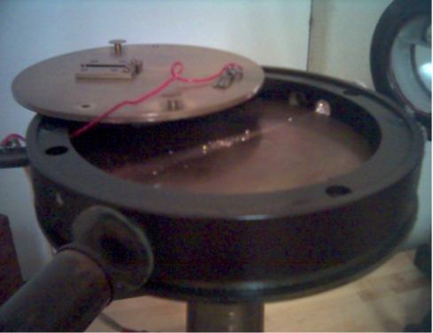
Experimental setup
From atomizer
D
V
Camera

Slide 3
Theoretical background
(1)
Stoke’s Law
(2)
Terminal velocity free fall
(3)
F_{d}
F_{b}
(4)
a
F_{g}
(5)
Get droplet radius and drag constant in terms of Vg, the measured quantity
(6)

Slide 4
Theoretical background
(7)
Terminal velocity under electric field
(8)
Substitute in Fg-Fb from (2)
F_{E}
F_{b}
(9)
Rearrange
a
E
F_{g}
F_{d}
(10)
Substitute in E=D/V and k from (6)

Slide 5
Theoretical background
(10) is inaccurate for droplets with radii comparable to mean free path between air molecules due to failure of Stoke’s Law. Since the droplet in fact experiences a drag force that is much smaller than that predicted by Stoke’s Law, using the measured value of v_{g} and v_{E} overestimates q.
(11)
Millikan’s correction factor
(12)
Obtain successive approximations of true droplet radius
Plug in true droplet radius into k₁ and correct v_{g} and v_{E} in (10)
(11)

Slide 6
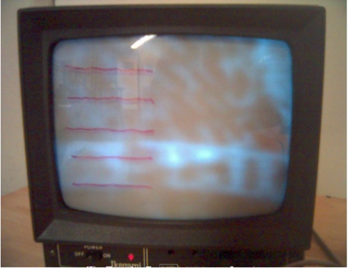
Measurement taking
Calibrate markings on monitor.
Spray oil droplets into capacitor chamber using atomizer.
Screen for droplets of proper size and charge.
Measure time t_{g} required to travel a certain number of increments under free fall.
Measure time t_{E} required to travel the same number of increments in the opposite direction under application of electric field.
Repeat measurements. At least two independent measurements of t_{g} and t_{E} are made for each droplet.

Slide 7
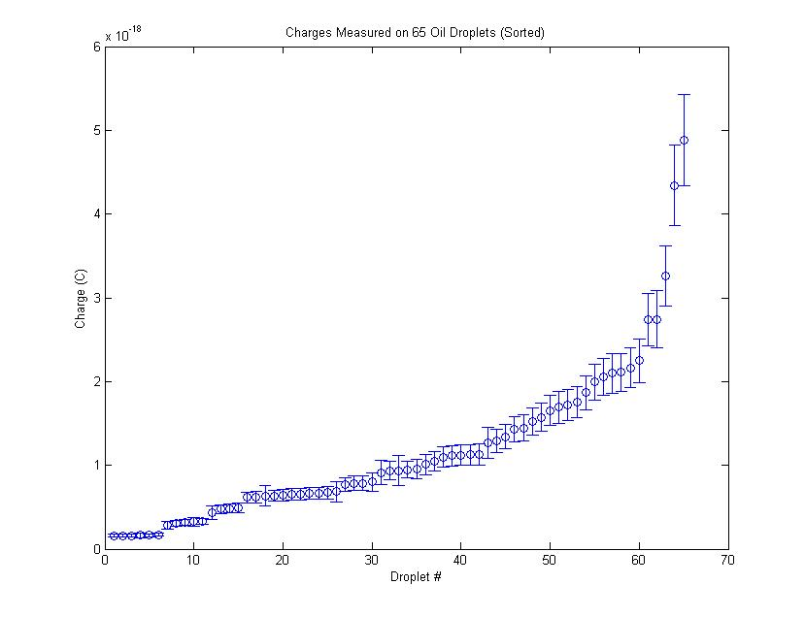
Results
Plateaus of charge measurements are observed
Indicate that charge is quantized

Slide 8
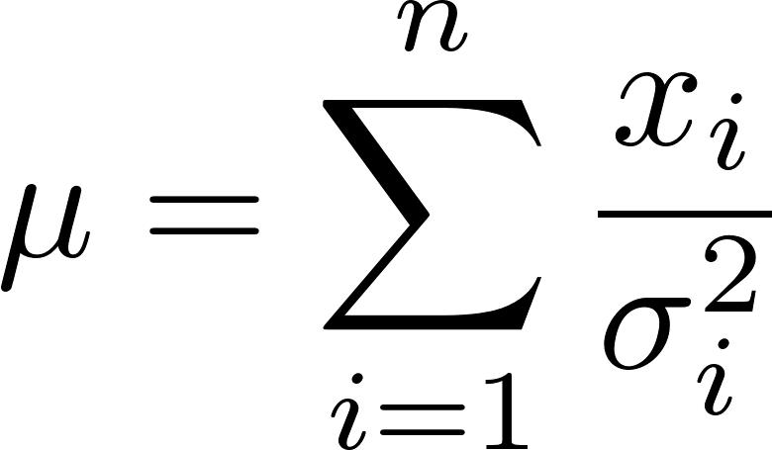
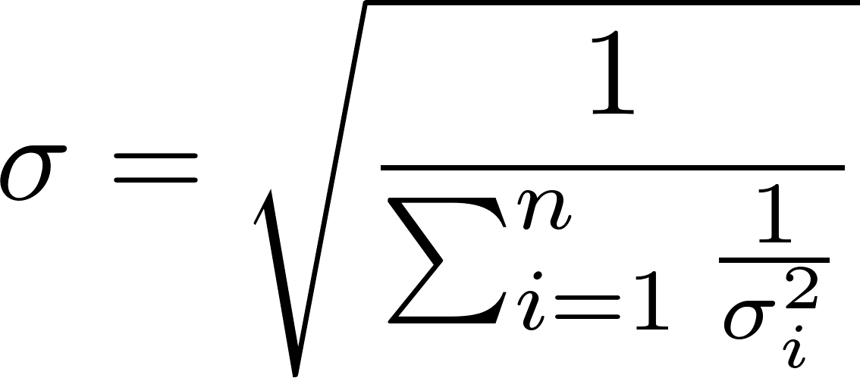
Determining the Charge Quantum
The droplets in each of the first five plateaus were used as estimates of the charges due to 1, 2, 3, 4 and 5 charge quanta
The maximum likelihood principle was used to calculate charge means and uncertainties for each plateau
Individual droplet charges belonging to the same plateau were weighted in the plateau average and uncertainty as follows, assuming a normal distribution:

Slide 9
Charge Values for the 1st Five Plateaus

Slide 10
Value of a Single Charge Quantum
Maximum likelihood principle was again used
The normalized charge values were weighted according to the normalized uncertainties, yielding

Slide 11
Comparison with Actual Electron Charge

Slide 12
Error Analysis
Relative uncertainties in calculated droplet charges are ~10-20%
Major contributors are
Relative error in the distance measurement (contributes ~10-15%)
Relative error in the timing measurement (contributes anywhere from 1 to 11%)
Future experiments can reduce the relative uncertainty by
calibrating distance markings
performing trials over a longer distance

Slide 13
Possible systematic error
Noticeable drift in the horizontal direction occurred during many of the trials
May be due to the photon-induced pressure from the illuminating lamp
May be a biasing factor
direction of the drag force is affected
terminal velocity may be different

Slide 14
Conclusion
It is significant that an undergraduate laboratory using the Millikan oil drop experiment can obtain a value of charge quantization within 0.26% of the actual value
This result demonstrates the remarkable simplicity and ingenuity of the setup proposed by Millikan

Slide 15
Bibliography
Millikan, R. A. On the Elementary Electrical Charge and the Avogadro Constant. Phys. Rev., 32, pp. 349-397, 1911.
Maximum likelihood. WolframMathWorld. http://mathworld.wolfram.com/MaximumLikelihood.html

